Slide 1
Retail Sales Forecast
Domain – Retails Sales

Slide 2
Overview :
This project focuses on forecasting retail sales by utilizing datasets that include features, sales, and store information. By leveraging time series analysis and machine learning techniques, we aim to predict future sales and gain insights into the factors that influence retail performance.

Slide 3
Description:
The goal of this project is to develop a comprehensive model for forecasting retail sales. We use three datasets:
1. Features_data_set.csv: Contains additional features related to the stores, such as promotions, markdowns, and holiday information.
2. sales_data_set.csv: Contains historical sales data for various stores and departments.
3. stores_data_set.csv: Contains metadata about the stores, including type and size.
Using these datasets, we preprocess the data, perform exploratory data analysis and build predictive models to forecast future sales. The final notebook includes detailed steps from data loading to model evaluation.

Slide 4
Tools Used :
Data Collection and Preparation - (Python, Pandas, NumPy)
Exploratory Data Analysis (EDA) - (Pandas, Matplotlib, Seaborn)
Visualization - (Plotly , Plotly Express)
Machine Learning - (Scikit-learn, statsmodels,)

Slide 5
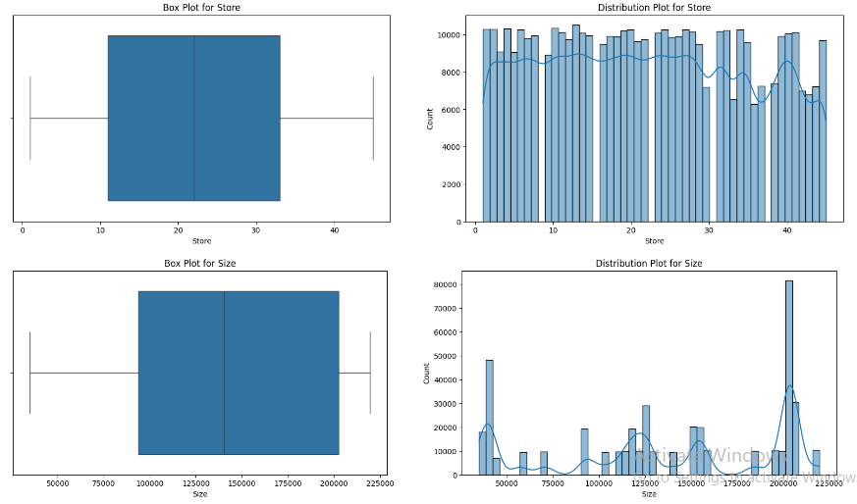
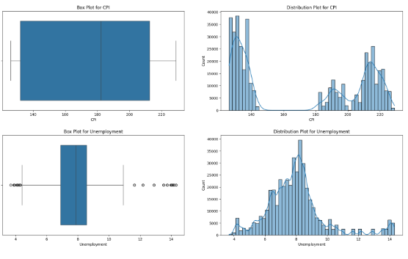
EDA Insights:

Slide 6
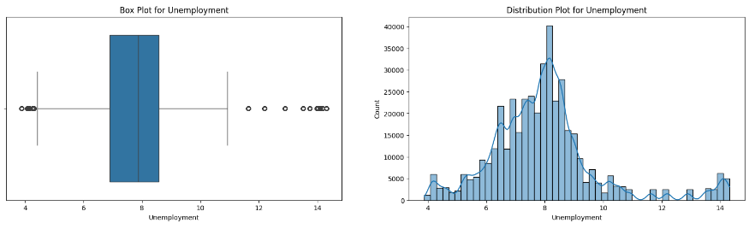
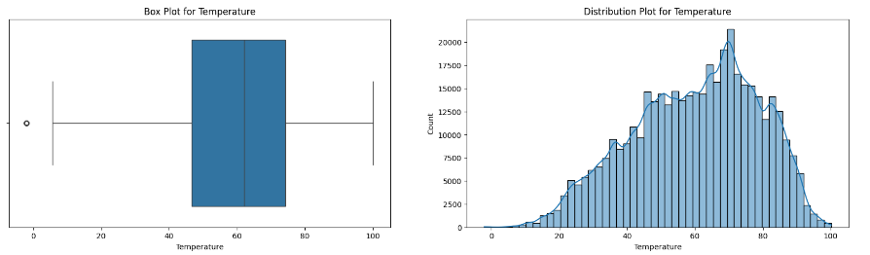
Box plot for Unemployment and Temperature

Slide 7
In this project, we successfully developed a predictive model for retail sales forecasting by integrating various datasets and applying data science techniques. Through data preprocessing, exploratory analysis, and model building, we were able to identify key factors affecting sales and generate accurate forecasts. These insights can aid retailers in making informed business decisions, optimizing inventory management, and enhancing promotional strategies. Future work can focus on incorporating more advanced models and exploring additional external data sources to further improve prediction accuracy
Conclusion :

